Slide 1
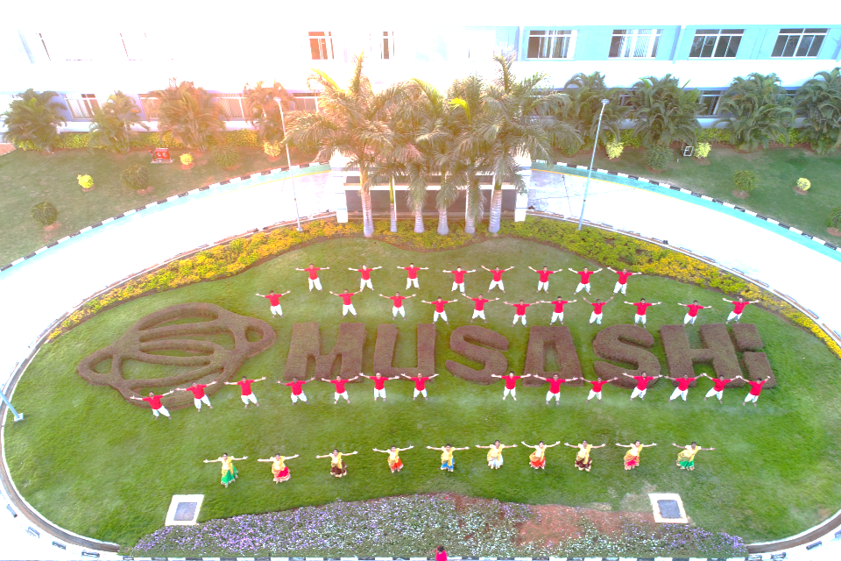
MUSASHI AUTO PARTS INDIA PVT LIMITEd
HORIZON
WELCOMES
YOU ALL to NHC-2018
No Limitations For Improvements……….
Notes:
All: First saying NAMASTHE
Sajin: We ARE FROM MUSASHI AUTO PART BLR PLANT. WELCOME YOU ALL FOR THE NH CIRCLE PRESENTATION.
WE ARE TEAM (ALL) HORIZON

Slide 2


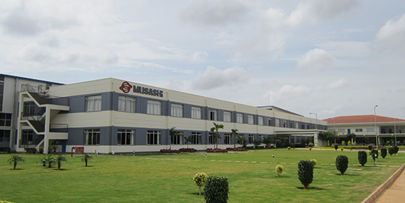












GLOBAL NETWORK
Global network makes optimal production and
supply system achievable. (30 Affiliates in 13 countries)
MUSASHI AUTO PARTS BENGALURU
6
5
EU
9 bases
Asia
16 bases
America
5 bases
: Musashi
30 PRODUCTION BASES GLOBALLY
: HAY Group

Slide 3






























OUR GLOBAL CUSTOMERS
Europe
North America
MAP-ID BLR CUSTOMERS
Japan
Asia
South America

Slide 4
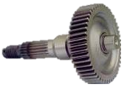
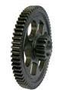
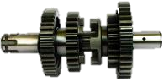
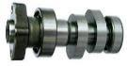
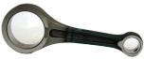
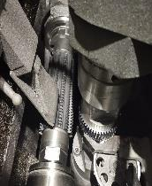
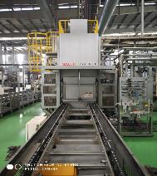
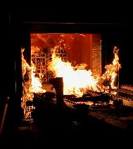
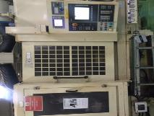
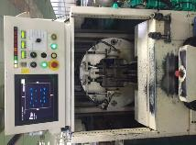
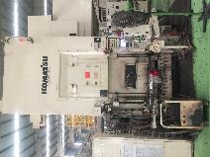
PLANT INTRODUCTION
WE MANUFACTURE
MOTOR CYCLE TRANSMISSION
SCOOTER TRANSMISSION
ENGINE GEAR
CAM SHAFT
CONNECTING ROD
KICK ASSY
OUR FACILITY
FORGING
GEAR CUTTING
HEAT TREATMENT
FINISHING
ASSEMBLY
WE WERE IN OPERATION SINCE 2013
Notes:
SAJIN: This is our plant introduction
SAJIN: We manufacture
MANOHAR: Motorcycle transmission
PRAMOD: Scooter
PRAVEEN: Engine gear
MANOHAR: Cam shaft
PRAMOD: Connecting rod
PRAVEEN: Kick assembly
SAJIN: Our facilities are
MANOHAR: Forging
PRAMOD: Gear cutting
PRAVEEN: Heat treatment
MANOHAR: grinding
PRAMOD: Assy
SAJIN: We were in operation since 2013

Slide 5
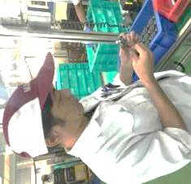
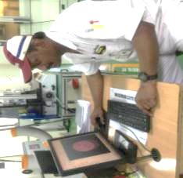
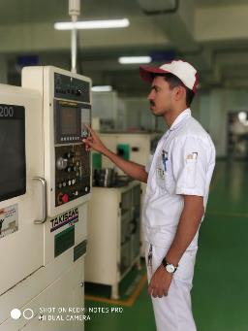
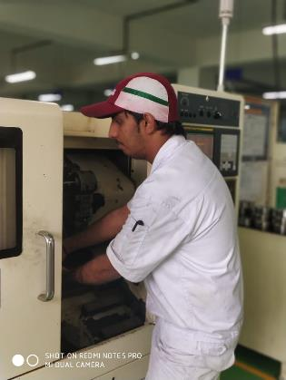
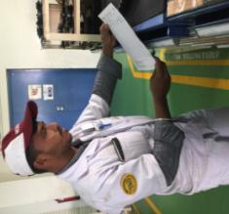
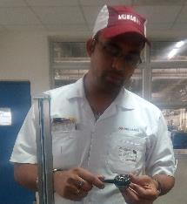
TEAM INTRODUCTION
ADVISOR
LEADER
HORIZON
TOTAL MEMBERS : 6 PERSON
NO OF MEETINGS : 20
TOTAL ATTENDANCE : 97%
KOHJI SUZUKI
STRENGTH: GIVING IDEAS
SAJIN ( Prod.)
STRENGTH: MACHINING
PRAVEEN (ME)
STRENGTH: PROGRAMMING
MANOHAR (Prod.)
STRENGTH: PART SETTING
PRAMOD (TRM)
STRENGTH: TOOLING
BHASKAR ( QA)
STRENGTH: SHARING INFORMATION
Notes:
Team

Slide 6

THEME SELECTION
Notes:
SAJIN: LETS IDENTIFY THE AREAS FOR IMPROVEMENTS.

Slide 7
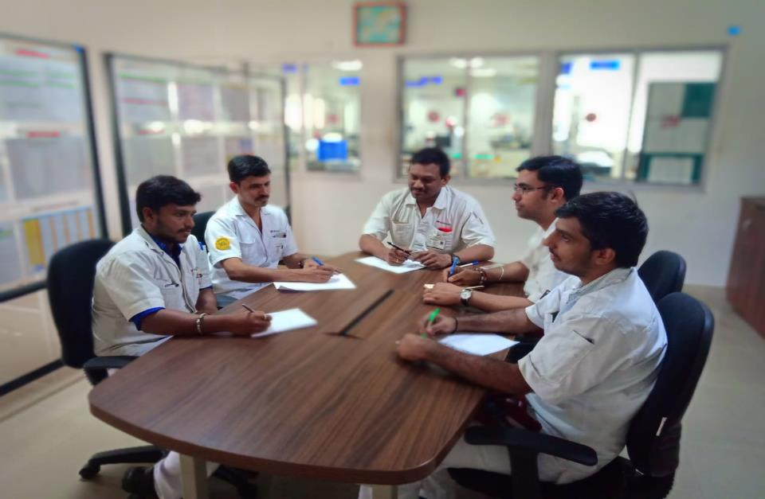
SELECTION OF THE THEME
PRODUCTIVITY IMPROVEMENT
REWORK REDUCTION
5S IMPROVEMENT
OEE IMPROVEMENT
REJECTION REDUCTION
CAPACITY IMPROVEMENT
Notes:
LETS EVALUATE THE PROBLEM BY KJ METHOD

Slide 8
EVALUATION BY KJ METHOD (JIRO KAVAKITA ANALYSIS)
 | SERIOUSNESS OF THE NEED FOR AN IMPROVEMENT |  |  | CIRCLE CAPABILITY |  |  | APPLICATION OF QC TOOLS | TOTAL EVALUATION POINTS | GRAPH OF EVALUATION POINTS
 | DEGREE OF IMPORTANCE | URGENCY | ECONOMC FACTOR | CAN EVERY ONE PARTICIPATE | CAN CIRCLE SOLVE PROBLEM BY THEMSELVES | CAN FINISH WITH IN THE TARGET TIME
REJECTION | ◎ | ◎ |  |  | ◎ | ◎
REWORK | ◎ |  |  | ◎ | ◎ | ◎ | ◎
PRODUCTIVITY
CAPACITY IMPROVEMENT | ◎ | ◎
◎
5 POINTS
EVALUATION CRITERIA
3 POINTS
PROBLEM POINT
1 POINT
27
31
13
17
PROBLEM EVALUATION BY KJ METHOD
Notes:
REWORK HAS GOT MAXIMUM POINTS SO WE SELECT REWORK FOR IMPROVEMENTS

Slide 9
TYPES OF REWORK
RUST PARTS
SPLINE TIGHT
OD DENT
SPLINE DENT
FORK TIGHT
FACE UNCLEAR
GEAR TEETH BURR
STEP MARK
BORE U/S
EXTRA MATERIAL
ON TEETH
GROOVE BURR
CUTTER MARK
GEAR TEETH DENT
Notes:
WHAT ARE THE MAJOR REWORK IN THE LINE
PRAVEEN: THERSE ARE THE REWORK IN THE LINE OUT OF THIS THE MAJOR REWORK WERE
SAJIN: LETS ANALYSE THE REWORK IN DETAILS

Slide 10
REWORK DETAILS
REWORK % OF ALL GEAR PARTS
FORK TIGHT REWORK PARTS
GEAR M3 IS 67%
FORK TIGHT REWORK IS 48%
TOTAL QTY : 5571 NOS
TOTAL QTY : 2228 NOS
DATA FROM MAY - 17 TO SEP - 17
THE CONTRIBUTION OF FORKTIGHT = 48%
THE MAIN PART CONTRIBUTING IS = GEAR M3
Notes:
PRAMOD: THE MAJOR REWORK WERE FORK TIGHT, OD DENT, BORE U/S & GEAR TEETH DENT. OUT OF WHICH FORK TIGHT IS CONTRIBUTING 48%.
SAJIN: IN WHICH PART FORK TIGHT IS COMIN MORE?
MANOHAR: THE MAJOR PARTS CONTRIBUTING TO FORK TIGHT IS M3,C4,C3,M4 . IN THIS GEAR M3 IS CONTRIBUTING MORE WHICH IS 67%.
SAJIN: LETS SELECT M-3 FOR THE IMPROVEMENTS

Slide 11

THEME
THEME
GEAR M-3 KTE FORK TIGHT REWORK ELIMINATION
TARGET
REDUCING FORK TIGHT REWORK TO
ZERO
Notes:
SAJIN: OUR THEME IS & OUR TARGET IS
PRAVEEN: THEME & TARGET ( ALL MEMBER SAY ZERO)

Slide 12

ACTIVITY SCHEDULE PLANNING
CIRCLE NAME: HORIZON
FACILITATOR:- KOHJI SUZUKI
1.SAJIN
2.PRAVEEN
3.MANOHAR
4. PRAMOD
5. BHASKAR
PROJECT:- FORK TIGHT REWORK ELIMINATION
START MONTH;- OCT-17-1W
END MONTH:- DEC-17 3W
MEMBERS
Meeting time every Friday 3 to 4 pm
NO OF PROJECTS COMPLETED:-1
SL NO | ITEM | PDCA | RESP | PLAN / ACTUAL | OCT-17 |  |  |  | NOV-17 |  |  |  | DEC-17
 |  |  |  |  | 1W | 2W | 3W | 4W | 1W | 2W | 3W | 4W | 1W | 2W | 3W | 4W
1 | SELECTION OF THE THEME | PLAN | TEAM | PLAN
 |  |  |  | ACTUAL
2 | GRASP THE CURRENT SITUATION & SETTING THE GOAL | PLAN | TEAM | PLAN
 |  |  |  | ACTUAL
3 | DRAWING THE ACTION | PLAN | TEAM | PLAN
 |  |  |  | ACTUAL
4 | ANALYSIS OF THE RELAVENT FACTORS | DO | TEAM | PLAN
 |  |  |  | ACTUAL
5 | EXAMINATION & IMPLEMENTATION OF COUNTERMEASURES | DO | TEAM | PLAN
 |  |  |  | ACTUAL
6 | CONFIRMATION OF THE EFFECTS | CHECK | TEAM | PLAN
 |  |  |  | ACTUAL
7 | STANDARDIZATION | ACT | TEAM | PLAN
 |  |  |  | ACTUAL
Notes:
PRAVEEN: THIS IS OUR ACTIVITY PLAN.

Slide 13

ANALYSIS OF THE PROBLEM

Slide 14

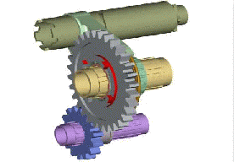
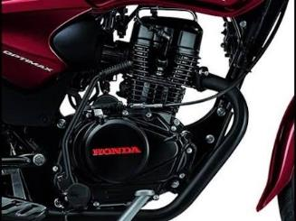
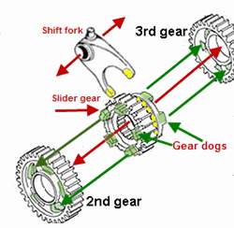
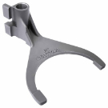
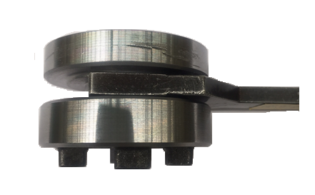
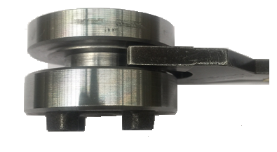
DEFINITION OF THE PROBLEM
WHAT IS FORK TIGHT ?
GAP
OK
NG
Notes:
SAJIN: WHAT IS FORK & HOW IT WORKS
PRAVEEN: THE FORK IS USED TO SHIFT THE GEARS & THIS IS HOW IT WORKS
SAJIN; WHAT IS FORK
PRAVEEN: EXPLAIN( OK & NG PART)
SAJIN: WHAT IS THE PROCESS FLOW OF GEAR M3?

Slide 15
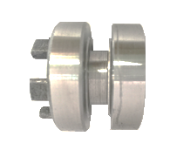
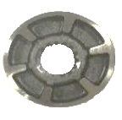


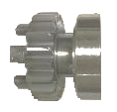
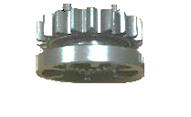
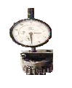
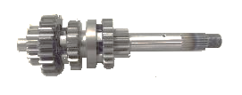
PROCESS FLOW OF GEAR M-3
SUSPECTED PROCESS
FORGING
TURNING-1
TURNING-2
BROACHING
HMSI -NARASAPURA
HEAT
TREATMENT
ASSEMBLY
INSPECTION
SHAPING
Notes:
MANOHAR: our manufacturing process start from. Forging
PRAMOD: turning-1
PRAVEEN: turning-2
MANOHAR: broaching
PRAMOD: shaping
PRAVEEN: heat treatment
MANOHAR: inspection
PRAMOD: assy
PRAVEEN: OUR BUSSINESS PARTNER IS HONDA
SAJIN: WHERE FORK TIGHT IS GENERATING?
PRAVEEN: TURNING-2
SAJIN: DID WE HAVE THE REWORK DATA?

Slide 16
BEFORE KAIZEN REWORK DATA
DATA SHOWING THE M-3 FORK TIGHT REWORK
AN AVERAGE OF 535 COMPONENTS WERE REWORKED IN EVERY MONTH.
267 MINUTES (4.5HRS) BEING UTILIZED FOR THE REWORK EVERY MONTH.
Notes:
PRAMOD: Yes I have collected the data from may to sep-17. (EXPLAIN)
SAJIN: 4.5 HRS WHICH IS VERY HIGH!!!! DID U ANALYSED REWORK PARTS IN DETAILS.??

Slide 17
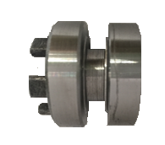
CURRENT SITUATION ANALYSIS
WHAT IS THE NG PARAMETERS IN THE FORK TIGHT PARTS?
LETS TAKE THE SAMPLE PARTS AND CHECK THE DEFECTS ….
INSPECTED REWORK PARTS
N=100
GROOVE WIDTH
Spec: 5.15 ~5.19
Spec: 5.15 ~5.19
Act : 5.1~ 5.13
Notes:
PRAMOD: I HAVE TAKEN 100 REWORK PART DATA. IN WHICH WD U/S, CHIP WELDING , GRV O/S ARE THE MAJOR PROBEMS. OUT OF WHICH WIDTH U/S CONTRIBUTING 75%
PRAVEEN: LETS DU THE SAKANA NO HONE ANALYSIS…

Slide 18

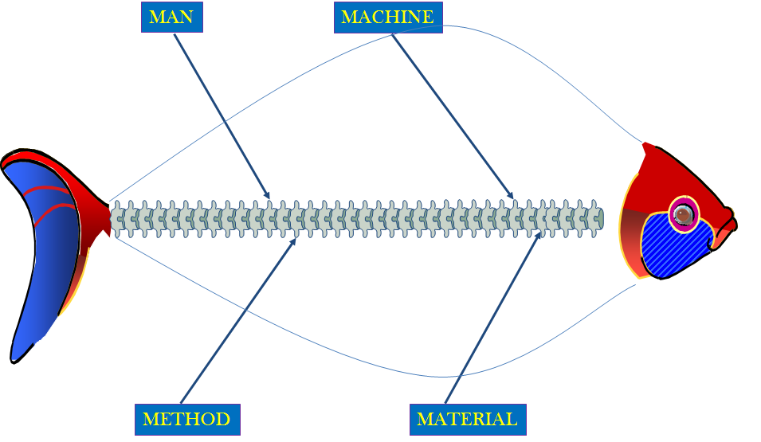
SAKANA NO HONE (FISH BONE)
GROOVE WIDTH U/S
COOLENT NOT COMING
UN SKILLED ASSOCIATE
OFFSET ERROR
TOOL HOLDING
AXIS REPEATABILITY ERROR
NG PART MOVING
PART CLAMPING
DISTORTION IN HT
INSERT WEAR
INSERT
INPUT STOCK VARIATION
VARIATION AFTER SHAPPING
GAUGING
HARDNESS VARIATION
Notes:
SAJIN: THE MAJOR FACTORS RELATED TO MACHINE
MANOHAR: 2 points read
SAJIN: man
PRAMOD: read points
SAJIN: method
PRAVEEN: read all points
SAJIN: there is no cause in material
PRAVEEN: there is no causes in material found
SAJIN: lets du the factor analysis on these problem points

Slide 19
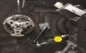

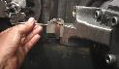
FACTOR ANALYSIS
S/NO.
Factor
Confirmation Points
Inspection Criteria
Observation /
Judge
Improvements points
1
MACHINE
AXIS
REPEATABILITY
WITHIN 16 MICRON
INSPECTED . FOUND
WITHIN 8 MICRON
2
MACHINE
TOOL HOLDING
TOOL TIGHTNESS
FOUND OK
3
METHOD
VARIATION AFTER
SHAPING
SHOULD NOT
VARRY
4
METHOD
DISTORTION IN
HT
AS PER PROCESS
SPEC
5
MAN
OFFSET ERROR
METHOD OF OFFSET
6
MATERIAL
INSERT LIFE
AS PER SET LIFE
Notes:
MANOHAR: Machine: 2 points( all together say….. Ok (loudly with thump show) after saying judgment is……….
PRAVEEN: NEXT VARIATION AFTER SHAPING

Slide 20
ANALYSIS ON SHAPING PROCESS
GROOVE WIDTH ( SPEC 5.15 ~5.19)
BEFORE
AFTER
INSPECTED THE GROOVE WIDTH IN SHAPPING PROCESS
THERE IS NO VARIATION FOUND BEFORE & AFTER .
Notes:
PRAVEEN: we checked the variation after shaping. HERE IS THE BEFORE & AFTER DATA. ALL DIMENTIONS ARE WITHIN SPEC.

Slide 21
FACTOR ANALYSIS
S/NO.
Factor
Confirmation Points
Inspection Criteria
Observation /
Judgement
Improvements points
C
1
MACHINE
AXIS
REPEATABILITY
WITHIN 16 MICRON
INSPECTED . FOUND
WITHIN 8 MICRON
2
MACHINE
TOOL HOLDING
TOOL TIGHTNESS
FOUND OK
3
METHOD
VARIATION AFTER
SHAPING
SHOULD NOT
VARRY
NO VARIATION
FOUND
4
METHOD
DISTORTION IN
HT
AS PER PROCESS
SPEC
5
MAN
OFFSET ERROR
METHOD OF OFFSET
6
MATERIAL
INSERT LIFE
AS PER SET LIFE
Notes:
PRAVEEN: so our judgement is “OK”(everyone with action)
Next we need to check distortion in HT.

Slide 22
DISTORTION STUDY IN HT
GROOVE WIDTH ( SPEC 5.11 ~ 5.17)
SOFT STAGE
HARD STAGE
9 POINT STUDY CONDUCTED.
GROOVE WIDTH OBSERVED WITHIN THE SPEC
Notes:
PRAVEEN: here we conducted 9 point study. Here we observed the spec within the limit . So there is no problem with HT

Slide 23
FACTOR ANALYSIS
S/NO.
Factor
Confirmation Points
Inspection Criteria
Observation /
Judgement
Improvements points
1
MACHINE
AXIS
REPEATABILITY
WITHIN 16 MICRON
INSPECTED . FOUND
WITHIN 8 MICRON
2
MACHINE
TOOL HOLDING
TOOL TIGHTNESS
FOUND OK
3
METHOD
VARIATION AFTER
SHAPING
SHOULD NOT
VARRY
NO VARIATION
FOUND
4
METHOD
DISTORTION IN
HT
AS PER PROCESS
SPEC
FOUND AS PER SPEC
5
MAN
OFFSET ERROR
METHOD OF OFFSET
DIFFICULTIES IN
GIVING OFFSET
X
INSERT CHANGE
BEFORE SET LIFE
X
6
MATERIAL
INSERT LIFE
AS PER SET LIFE
WE HAVE DONE FACTOR ANALYSIS OF ALL
POTENTIAL CAUSES .
Notes:
Praveen: so our judgement is … “OK”(everyone)
Pramod: explain both points(all together say “DAAME” with hand action)

Slide 24

FACTOR ANALYSIS
S/NO.
Factor
Confirmation Points
Inspection Criteria
Observation /
Judgement
Improvements points
1
MACHINE
AXIS
REPEATABILITY
WITHIN 16 MICRON
INSPECTED . FOUND
WITHIN 8 MICRON
2
MACHINE
TOOL HOLDING
TOOL TIGHTNESS
FOUND OK
3
METHOD
VARIATION AFTER
SHAPING
SHOULD NOT
VARRY
NO VARIATION
FOUND
4
METHOD
DISTORTION IN
HT
AS PER PROCESS
SPEC
FOUND AS PER SPEC
5
MAN
OFFSET ERROR
METHOD OF OFFSET
DIFFICULTIES IN
GIVING OFFSET
X
INSERT CHANGE
BEFORE SET LIFE
X
6
MATERIAL
INSERT LIFE
AS PER SET LIFE
Notes:
PRAMOD: lets focus on offset error

Slide 25
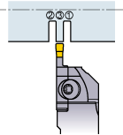
ANALYSIS ON ROOT CAUSE
TOOL OFFSET WILL BE ONE OF THE REASON FOR GROOVE WIDTH U/S
LETS ANALYSE THE CURRENT OFFSET CONDITION & WILL CORRECT THE ISSUE
T13
BEFORE
T03
T03
T13
OFFSET Z – 0.02
OFFSET Z +0.02
G99G97S2000T303
G0X46.35
Z-21.15
G1X22.85F0.12
T13
G0X35.0
G1Z-20.11
G1X22.8F0.12
DOUBLE
OFFSET
Z -
Z +
Z -
Z +
2 OFFSET FOR GROOVE WIDTH CORRECTION
Notes:
Sajin: WHAT IS EERROR IN OFFSET?
Praveen: IN THE CURRENT PROGRAM DOUBLE OFFSET USING. WHICH IS T3 & T13. ONE IS LEFT SIDE & OTHER ONE IS RIGHT SIDE…
SAJIN: HAVE YOU CORRECTED THIS OFFSET?

Slide 26
ANALYSIS ON ROOT CAUSE
BEFORE
AFTER
T03
G99G97S2000T303
G0X46.35
Z-21.15
G1X22.85F0.12
GOX35.0
G1Z-20.03
G1X22.8
G04X05
T03
T03
T13
Z -
Z +
DOUBLE
OFFSET
SINGLE
OFFSET
2 OFFSET FOR GROOVE WIDTH CORRECTION
SINGLE OFFSET FOR GROOVE WIDTH CORRECTION
Notes:
SAJIN: WHAT IS THE RESULT AFTER OFFSET CORRECTION
CLICK
PRAVEEN : THE FORK TIGHT REWORK HAS NOT BEEN REDUCEED
CLICK

Slide 27
FACTOR ANALYSIS
S/NO.
Factor
Confirmation Points
Inspection Criteria
Observation /
Judgement
Improvements points
1
MACHINE
AXIS
REPEATABILITY
WITHIN 16 MICRON
INSPECTED . FOUND
WITHIN 8 MICRON
2
MACHINE
TOOL HOLDING
TOOL TIGHTNESS
FOUND OK
3
METHOD
VARIATION AFTER
SHAPING
SHOULD NOT
VARRY
NO VARIATION
FOUND
4
METHOD
DISTORTION IN
HT
AS PER PROCESS
SPEC
FOUND AS PER SPEC
5
MAN
OFFSET ERROR
METHOD OF OFFSET
DIFFICULTIES IN
GIVING OFFSET
INSERT CHANGE
BEFORE SET LIFE
X
6
MATERIAL
INSERT LIFE
AS PER SET LIFE
Notes:
PRAMOD: LETS FOCUS ON INSERT LIFE

Slide 28




CURRENT CONDITION
WHICH INSERT IS BEING USED NOW
LETS VERIFY AT GEMBA
CURRENT INSERT | A4G0405M04U04 GMN
SET LIFE | 500
ACTUAL LIFE | 200 ~ 250
CUTTING SPEED | 160
FEED | 0.2
MAKE | KENNAMETAL
WHY INSERT
CHANGING
BEFORE SET
LIFE ?
IS THERE GROOVE WIDTH
VARIATION IN BETWEEN ?
WHAT IS TO BE DONE ?
LETS ANALYSIS IN DETAILS…
Notes:
MANOHAR : LETS VERIFY @ GEMBA
Praveen – insert detail explanation

Slide 29
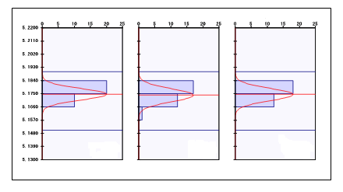
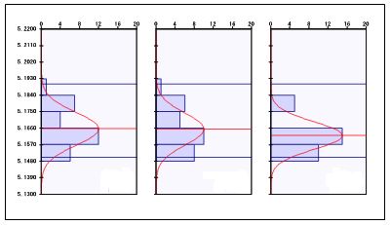
ANALYSIS ON CURRENT SITUATION
GROOVE WIDTH VARIATION MONITORING
LIFE MONITORED FOR CURRENT INSERT OF
QTY – 3 NOS
INITIAL TIME
END OF TOOL LIFE
TRAIL-1
TRAIL-2
TRAIL-3
TRAIL-1
TRAIL-2
TRAIL-3
Cp – 1.699
Cp – 1.504
Cp – 1.578
Cp – 0.743
Cp – 0.762
Cp – 0.889
ANALYSIS DONE ON TURNING-2 TO FIND OUT THE VARIATION IN GROOVE WIDTH
FOUND THAT GROOVE WIDTH VARIATION BEFORE SET LIFE.
Inference; we identified 12 causes .
Notes:
PRAVEEN: WE HAVE CHECKED THE CP AT THE STARTING OF TOOL LIFE - FOUND OK ( ALL WITH ACTION)
WE HAVE CHECKED THE CP AT THE STARTING OF TOOL LIFE - FOUND NG ( ALL WITH ATION)
SAJIN : LETS DO WHY WHY ANALYSIS

Slide 30





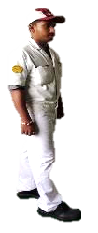
Why-Why ANALYSIS
CUTTING PARAMETER TO BE PUT AS PER LOGICAL CALCULATION
CUTTING PARAMETERS ARE NOT AS PER LOGIC
CUTTING PARAMETER NG
INSERT GET CHIPPED OFF BEFORE SET LIFE
INSERT CHANGE BEFORE SET LIFE
HOW
WHY
WHY
WHY
Notes:
PRAVEEN : WORDINGS
SAJIN : WHY & HOW
WHAT IS LOGICAL CALCULATION

Slide 31
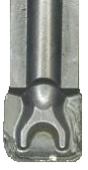
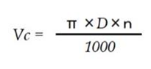
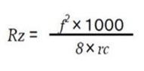
CUTTING PARAMETER CHECK
PRESENT INSERT CONDITION
LOGICAL CALCULATIONS AS FOLLOWS
CUTTING SPEED
FEED CALCULATION
CURRENT PROGRAM
G99G97S2000T303
G96 S160
G0 X46.35
G0 Z-21.15
G1 X22.8 F0.2
G0X35.0
G1 Z-20.03
G1 X22.8 F0.2
LOGICAL FEED & CUTTING SPEED
Rz max | 12.5
Cutting speed | Vc 100 ~ 140
Feed | F 0.12
CUTTING PARAMETER ARE NOT USED AS PER LOGICAL CALCULATION .
Notes:
PRAVEEN: here u can see the present insert corner which is wear out. So to improve insert life we need to fix the cutting speed & feed according to formulas. & we fixed this by using formulas. & wen we checked in the current program we found that speed & feed out of standard value which causes Problem.
Lets modify the program & implement
SAJIN : HAVE WE TAKEN TRIAL WITH THE

Slide 32



LOGICAL DATA IMPLEMENTATION
BEFORE
AFTER
G99G97S2000T303
G96 S160
G00 X46.35
G00 Z-21.15
G01 X22.8 F0.2
G00X35.0
G01 Z-20.03
G01 X22.8 F0.2
G99G97S2000T303
G96 S120
G00 X46.35
G00 Z-21.15
G01 X22.8 F0.12
G00X35.0
G01 Z-20.03
G01 X22.8 F0.12
BEFORE
AFTER
PARAMETERS CHANGED AS PER THE LOGICAL CALCULATION.
WHY TOOL LIFE NOT ACHIEVED ? LETS CHECK FOR ALTERNATIVE GRADES
Notes:
PRAVEEN: Here we implemented the speed from 160 to 120 & feed from 0.2 to 0.12. after this we monitored the tool life. But toll life reaches to only 350 nos against 500. GROOVE WIDTH VARIATION STARTED AFTER 340 NOS
SAJIN: Why tool life not achieved?
PRAVEEN: Can we go for other alternative grades?
PRAMOD: lets check the grades

Slide 33
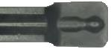
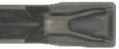
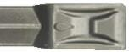
INSERT SELECTION
 | CHIP BREAKER TYPE | PICTURE | APPLICATION
CURRENT INSERT | A4G0405M04U04-GMN |  | FOR GROOVING STEEL, CAST IRON
ALTERNATE GRADE | DTE400-040 T9125 |  | FOR GROOVING STEEL, STAINLESS STEEL,NON FERROUS & HIGH TEMP ALLOY
 | A4G0405M04U04-GUP |  | FOR GENERAL PURPOSE, UNIQUE CHIP BREAKER MAKES CHIPS SHORTER
 | DTE400-040 AH7025 |  | FOR HIGH PRECISION MACHINING
 | GY2M0400G040N-MM |  | FOR HIGH PRECISION MACHINING
 | GDM4020N-040 GM |  | ESPECIALLY FOR ALLOY STEEL WITH MEGA COATING UPTO 40HRC
INSERT IS SELECTED BY CONSIDERING THE GEOMETRY, THE CHIP BREAKING ABILITY AND ADVICE FROM THE ADVISOR.
Notes:
PRAMOD: current insert we are using GMN grade , which is used for grooving the steel & cast iron. but life not reaches. So we selected other suitable inserts , in this we selected gup grade because it is good chip breaker & also this is unique chip breaker. Lets du the trail with this insert

Slide 34

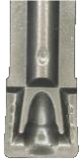
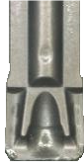


NEW CHIP BREAKER TRIALS
BEFORE
AFTER
 | BEFORE | AFTER
CURRENT INSERT | A4G0405M04U04 GMN | A4G0405M04U04 GUP
SET LIFE | 500 | 500
ACTUAL LIFE | 350 | 500
CUTTING SPEED | 120 | 120
FEED | 0.12 | 0.12
MAKE | KENNAMETAL | KENNAMETAL
INSERT CORNER WEAR OUT AFTER 500 NOS
NEW
USED
TOOL LIFE IMPROVED .
WHY FORK TIGHT COMPONENT AGAIN GENERATED?
LETS DO THE ANALYSIS FOR FURTHER IMPROVEMENT .
Notes:
PRAMOD: (explain before & after) after trail tool life reaches to the target. & we monitored the fork tight . But the result is NG
SAJIN: then why fork tight generating again?
PRAMOD: lets do the analysis for further improvement
SAJIN: so u analysed again . What ng parameters u found?

Slide 35
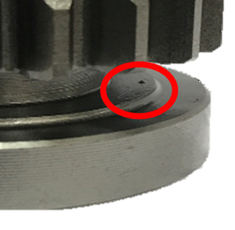
CURRENT SITUATION ANALYSIS
WHAT IS THE NG PARAMETERS IN THE FORK TIGHT PARTS?
LETS CHECK THE DEFECT PART TO FIND THE CAUSE
BEFORE KAIZEN
ALL MACHINE INSERTS NOT CHANGED, DUE TO THIS REASON STILL GROOVE WIDTH U/S PARTS AVAILABLE
Oct-3rd WEEK
N=100
TOTAL QTY: 154
WE TOOK SAMPLE PARTS & CHECKED WHICH PARAMETER IS AFFECTING THE FORK TIGHT.
WE FOUND THE CHIP WELDING CONTRIBUTING MORE IN FORK TIGHT.
Notes:
PRAVEEN: Yes. Again we analyzed & here we observed that width u/s reduced from 75 to 32%. But after this chip contributing 68%. Lets du analysis to avoid this chip welding

Slide 36
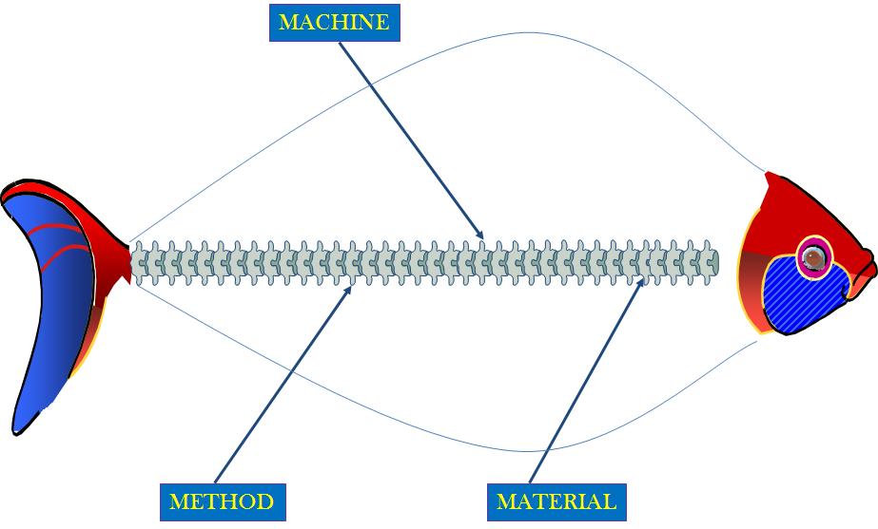
SAKANA NO HONE (fish bone)
CHIP WELDING
COOLENT FLOW
IMPROPER MACHINING
INSERT CHIPOFF
TOOL INTERUPTION
GROOVE TOOL DESIGN
TOOL PATH
INPUT STOCK VARIATION
CHIP BREAKING
HARDNESS VARIATION
Notes:
SAJIN: Lets put the suspected causes in sakana no hone
SAJIN: machine, method (read points)
PRAMOD:( read machine points)
PRAVEEN: (read method 2 points)

Slide 37


FACTOR ANALYSIS
S/NO. | Factor | Confirmation Points | Inspection Criteria | Observation / Improvements points | Judgement
1 | MACHINE | TOOL INTURRUPTION | REQUIRED GAP BETWEEN TOOL & GROOVE FACE
2 | MACHINE | INSERT CHIPOFF | SHOULD NOT CHIP OFF
3 | METHOD | CHIP BREAKER | CHIP SHOULD BREAK
4 | METHOD | TOOL PATH | CUTTING DIRECTION
FOUND GAP BETWEEN TOOL & GROOVE FACE
NO INSERT CHIP OFF
GOOD CHIP BREAKING
CUTTING DIRECTION FOUND NG
X
Notes:
PRAMOD: (machine points)
PRAVEEN: (method points)

Slide 38
FACTOR ANALYSIS
S/NO. | Factor | Confirmation Points | Inspection Criteria | Observation / Improvements points | Judgement
1 | MACHINE | TOOL INTURRUPTION | GAP BETWEEN TOOL & TOOL FACE
2 | MACHINE | INSERT CHIPOFF | SHOULD NOT CHIP OFF
3 | METHOD | CHIP BREAKER | CHIP SHOULD BREAK
4 | METHOD | TOOL PATH | CUTTING DIRECTION
CHECKED . FOUND OK
CHECKED. FOUND OK
CHIP BREAKING FOUND OK
CUTTING DIRECTION FOUND NG
X
Notes:
PRAMOD: lets focus on tool path
SAJIN WHAT IS THE ERROR IN TOOL PATH

Slide 39


TOOL PATH MODIFICATION
CHECKED THE TOOL PATH , CORRECTION NEEDS TO BE DONE
BEFORE
AFTER
G00 Z-21.15
G01 X22.8 F0.12
G00X35.0
G01 Z-20.03
G01 X22.8 F0.12
G01Z-21.15
G01 X35.0F0.12
G00X50.0
G01 X22.8 F0.12
G00X35.0
G01 Z-20.03
G01 X22.8 F0.12
G01Z-21.15
G00X35.O W0.3F0.12
G01 Z-21.15
G01 X22.8 F0.12
RETURN FINISHING CUTTING PATH
FORWARD FINISHING CUTTING PATH
TOOL PATH CORRECTION
TOOL PATH MODIFIED & OBSERVED FOR A WEEK .
FORK TIGHT COMPONENT AGAIN FOUND.
WHY FORK TIGHT COMING ? LETS ANALYSIS .
Notes:
PRAVEEN: Here in the before picture u can see that cutting direction is from bottom to top, which is against the cutting path for the grooving . Then we changed this to top to bottom & fixed in the program. We implemented this & monitored the fork tight . We obsereved that still fork tight not eliminated
SAJIN: Why again fork tight coming.
PRAVEEN: lets analysis

Slide 40





REASONING
1
2
TOOL LIFE ACHIEVED
OFFSET CORRECTED
3
1
2
3
TOOL PATH CORRECTED
THEN WHY IS THE FORK TIGHT COMING AGAIN ?
LETS DO THE BRAINSTORMING AGAIN & FIND OUT OTHER SUSPECTED CAUSES
Notes:
PRAVEEN: ( read 4 points)
Comment as per photo appears NO LOOK SPEAK BETTER !

Slide 41
BRAIN STORMING
Problem: Groove Width U/S
PARTS INSPECTION
GROOVE WIDTH VARIATION
INSERT TOLERANCE
INSERT CLAMP
Notes:
SAJIN: Lets du the brain storming
Read points as per appears NO LOOK SPEAK BETTER !

Slide 42


FACTOR ANALYSIS
S/NO. | Confirmation Points | Inspection Criteria | Observation / Improvements points | Judgement
1 | PARTS NOT INSPECTING | PARTS SHOULD INSPECT AS PER PROCESS
2 | GROOVE WIDTH VARIATION INBETWEEN | NO VARIATION ALLOWED
3 | INSERT CLAMP | NO INSERT PLAY
4 | INSERT TOLERANCE | INSERT SPEC W.R T PART QUALITY
INSPECTING AS PER DEFINED
CHECKED FOUND OK
FOUND OK
VARIATION IN INSERT & PART TOLERANCE
X
Notes:
PARVEEN: 1 point
PRAMOD: 2 point
MANOHAR: 3 point
PRAVEEN: 4 point

Slide 43
FACTOR ANALYSIS
S/NO. | Confirmation Points | Inspection Criteria | Observation / Improvements points | Judgement
1 | PARTS NOT INSPECTING | PARTS SHOULD INSPECT AS PER PROCESS
2 | GROOVE WIDTH VARIATION INBETWEEN | NO VARIATION ALLOWED
3 | INSERT CLAMP | NO INSERT PLAY
4 | INSERT TOLERANCE | INSERT TOLERANCE W.R.T PART QUALITY
INSPECTING AS PER DEFINED
CHECKED FOUND OK
FOUND OK
INSERT TOLERANCE & OFFSET
X
Notes:
PARVEEN: 1 point
PRAMOD: 2 point
MANOHAR: 3 point
PRAVEEN: 4 point

Slide 44
INSERT ANALYSIS
CHECKED THE INSERTS, FOUND VARIATION IN DIFFERENT BATCHES
BATCH NO: 3774691 |  | BATCH NO:3791293 |  | BATCH NO:4086935
SL NO | INSERT SPEC | SL NO | INSERT SPEC | SL NO | INSERT SPEC
1 | 4.085 | 1 | 4.124 | 1 | 3.985
2 | 4.083 | 2 | 4.126 | 2 | 3.986
3 | 4.084 | 3 | 4.125 | 3 | 3.986
4 | 4.085 | 4 | 4.126 | 4 | 3.984
5 | 4.085 | 5 | 4.127 | 5 | 3.985
6 | 4.086 | 6 | 4.124 | 6 | 3.985
7 | 4.084 | 7 | 4.124 | 7 | 3.984
8 | 4.086 | 8 | 4.125 | 8 | 3.985
9 | 4.085 | 9 | 4.124 | 9 | 3.986
10 | 4.084 | 10 | 4.125 | 10 | 3.984
CURRENT INSERT
4.12±0.08
Max
TOLERANCE : 0.16MM
PROCESS SPEC
Gap = 0.143mm
Min
5.15 ~ 5.19
TOLERANCE : 0.04MM
THE MAX VARIATION FOUND IS 0.143 MM.
WHY VARIATION COMING IN DIFFERENT BATCHES ? .
Notes:
SAJIN: We have taken 3 batch insert for the analysis , we have checked the width of each insert .
Praveen : why the variation is coming more ?
Sajin : The insert have a std tolerance of 4.12
Praveen : our part tolerance is only 40 micron
Pramod : For achieving this tolerance we need insert having tolerance less than 40 micron
Praveen : we need a precision ground inset for this application
Sajin : lets take trial with the ground insert.

Slide 45

INSERT TRIAL 1
WE NEED THE PRECISSION GROUND INSERT HAVING ±0.020 TOLERENCE FOR THIS APPLICATION
CURRENT INSERT | A4G0405M04U04 GUP | DTE400 – 040 T9125
TOLERANCE | ± 0.08 | ± 0.020
SET LIFE | 500 | 500
ACTUAL LIFE | 500
CUTTING SPEED | 120 | 120
FEED | 0.12 | 0.12
MAKE | KENNAMETAL | TUNGALOY
BEFORE
AFTER
TRAIL-1
TRAIL-2
20
30
DTE400-040 –GROUND
TOLERANCE ±0.02
TAKEN TRIALS WITH THE GROUND INSERT – LIFE NOT ACHIEVED DUE TO INSERT WEAR OUT .
PRECISION GROUND INSERT WILL NOT IMPROVE THE LIFE, SHOULD WE GO FOR MOULDED INSERT?
Notes:
MANOHAR : TAKEN TRIAL WITH THE GROUND INSERT IN 1ST TRIAL THE LIFE IS 20 NOS & 2ND TRIAL THE LIFE IS 30 NOS
PRAVEEN : I THINK THE GROUND WILL NOT WORK HERE.
LETS SEARCH FOR A MOLDED INSERT WITH LESSER TOLERANCE
SAJIN : DID YOU FOUND ANY MOULDED INSERT WITH TOLERNCE LESS THAN 40 MICRON

Slide 46
INSERT SELECTION
CHECKED FOR THE MOULDED INSERT WITH LEAST TOLERANCE
SELECTED GDM4020N-040 GM HAVING TOLERANCE OF ± 0.02 MM
TRAIL INSERT
BATCH NO: R0529E4 |  | BATCH NO:R1033EZ |  | BATCH NO: N113905
SL NO | INSERT SPEC | SL NO | INSERT SPEC | SL NO | INSERT SPEC
1 | 3.971 | 1 | 3.970 | 1 | 3.975
2 | 3.975 | 2 | 3.967 | 2 | 3.975
3 | 3.973 | 3 | 3.970 | 3 | 3.970
4 | 3.971 | 4 | 3.974 | 4 | 3.971
5 | 3.974 | 5 | 3.973 | 5 | 3.968
6 | 3.969 | 6 | 3.972 | 6 | 3.973
7 | 3.971 | 7 | 3.973 | 7 | 3.974
8 | 3.975 | 8 | 3.969 | 8 | 3.970
9 | 3.973 | 9 | 3.967 | 9 | 3.968
10 | 3.971 | 10 | 3.967 | 10 | 3.975
4.00±0.02
Max
GDM4020N-040 GM
PROCESS SPEC
Gap = 0.008mm
Min
5.15 ~ 5.19
TOLERANCE : 0.04MM
TO STUDY BATCH TO BATCH VARIATION ARRANGED 3 BATCHES
THE MAXIMUM VARIATION FOUND IS 0.008 MM.
DECIDED TO GO WITH THIS INSERT FOR FURTHER TRIALS .
Notes:
SAJIN: did u found any moulded inserts ?
PRAMOD: yes . I found moulded inserts having tolerance of 0.02mm. Taken 3 batches for the analysis in that found the range
SAJIN: good the insert size variation is less than 0.008 which is less than our part tolerance , lets take trials with this insert.
PRAMOD: Yes. Here is the data. (explain MAX & MIN).here gap is 0.008mm
SAJIN: then du the trail with this insert

Slide 47



INSERT TRIAL 2
BEFORE
AFTER
 | BEFORE | AFTER
CURRENT INSERT | A4G0405M04U04 GUP | GDM 4020N -040GM
TOLERANCE | ± 0.08 | ± 0.02
SET LIFE | 500 | 500
ACTUAL LIFE | 500 | 700
CUTTING SPEED | 120 | 120
FEED | 0.12 | 0.12
MAKE | KENNAMETAL | KYOCERA
ACTION-1
INSERT WEAR FOUND OK
ACTION-2
ACTION-3
ACTION-4
NEW
USED
TRIAL SUCCESSFUL AND TOOL LIFE ACHIEVED 700 NOS .
Notes:
PRAMOD: We taken GDM insert for trail, here tool life nimproved from 500 to 700. and we monitored the fork tight .
SAJIN: Any improvement found after this trail?
PRAMOD: Yes . A huge improvement found . Fork tight rework is eliminated

Slide 48
EFFECT CONFIRMATION
Notes:
SAJIN

Slide 49

EFFECT CONFIRMATION
INSERT CHANGE
1
2
OFFSET CHANGE
TOOL PATH CHANGE
3
4
INSERT TOLERANCE CHANGE
CHANGE OVER
AFTER IMPLIMENTATION ALL THE KAIZENS FORK TIGHT REWORK ELIMINATED .
Notes:
SAJIN

Slide 50
ACTIVITY SCHEDULE PLANNING
CIRCLE NAME: HORIZON
FACILITATER:- KOHJI
1.SAJIN
2.PRAVEEN
3.MANOHAR
4. PRAMOD
5. BHASKAR
PROJECT:- FORK TIGHT REWORK ELIMINATION
START MONTH;- OCT-17-1W
END MONTH:- DEC-17 3W
MEMBERS
Meeting time every Friday 3 to 4 pm
NO OF PROJECTS COMPLETED:-1
SL NO | ITEM | PDCA | RESP | PLAN / ACTUAL | OCT-17 |  |  |  | NOV-17 |  |  |  | DEC-17
 |  |  |  |  | 1W | 2W | 3W | 4W | 1W | 2W | 3W | 4W | 1W | 2W | 3W | 4W
1 | SELECTION OF THE THEME | PLAN | TEAM | PLAN
 |  |  |  | ACTUAL
2 | GRASP THE CURRENT SITUATION & SETTING THE GOAL | PLAN | TEAM | PLAN
 |  |  |  | ACTUAL
3 | DRAWING THE ACTION | PLAN | TEAM | PLAN
 |  |  |  | ACTUAL
4 | ANALYSIS OF THE RELAVENT FACTORS | DO | TEAM | PLAN
 |  |  |  | ACTUAL
5 | EXAMINATION & IMPLEMENTATION OF COUNTERMEASURES | DO | TEAM | PLAN
 |  |  |  | ACTUAL
6 | CONFIRMATION OF THE EFFECTS | CHECK | TEAM | PLAN
 |  |  |  | ACTUAL
7 | STANDARDIZATION | ACT | TEAM | PLAN
 |  |  |  | ACTUAL
DUE TO SOME FAILED TRIALS THERE IS A DELAY IN IMPLEMENTATION, BUT WE COMPLETED OUR ACTIVITY AS PER THE PLAN
Notes:
SAJIN

Slide 51
HORIZONTAL DEPLOYMENT
HORIZONTAL DEPLOYMENT PLAN / ACTUAL
C-4 KTE / K67, C-3 K55 & M-4 K55 LINE
Notes:
SAJIN

Slide 52
TANGIBLE BENEFITS
INVESTMENT :
INR 29,640
SAVINGS FROM
NOV 2017-MAR 2018
TOTAL SAVINGS :
INR 597,819
TOOL LIFE UP
REWORK ELIMINATED
Notes:
PRAVEEN

Slide 53







STANDARDIZATION
MACHINE PROGRAM APPROVED
UPDATED TOOL LIST
PROGRAM APPROVED & UPDATED IN MACHINE
CHANGED TOOL UPDATED IN TOOL LIST , SO WITHOUT INFORMATION TOOL CANNOT CHANGE
CONTROL PLAN & FMEA
PROCESS SHEET
FMEA CONDUCTED AFTER THIS PROJECT
CHANGE POINT UPDATED IN PROCESS SHEET & ISSUED TO PRODUCTION
Notes:
PRAVEEN

Slide 54





QC TOOLS & TECHNICS USED
We used following QC tools & Techniques for our project
Histogram
Why-why analysis
Cause and Effect Diagram
Brain storming
9 Point Study
Graph
Notes:
MANOHAR

Slide 55

LEARNINGS
PROBLEM SOLVING TECHNIQUES
USAGE OF QC TOOL IN ANALYSIS
LEARNED HOW TO ANALYSE THE PROBLEM
OUR NEXT CHALLENGE
Center Damage
CENTER DAMAGE REDUCTION IN SHAFT LINE
Notes:
PRAVEEN: read first 3 points
SAJIN: Last points
BE TOGETHER ALL MEMBER LOUD “NEXT CHALLENGE !!”

Slide 56

THANK YOU
Notes:
BE TOGETHER

